Slide 1


MAE 589- HEAT TRANSFER PROJECT
HEAT TRANSFER AND THERMAL INSULATION DESIGN OF A MILITARY DRONE
RIIPEN PROJECT ~ (ARMADA DEFENCE CORP)
The objective of this project is to provide an insulation and design solution for a 2stroke IC engine equipped in an aviation drone whose fuel is to be insulated from the thermal output of the engine.
The goal is to introduce an effective insulation material into the pre-existing design of the drone and come up with improved results.
The project includes working with the designing of insulation parts, CFD analysis, thermal modeling and material selection.
ANUPAMA S J KANCHUSTAMBAM (1225758846)
SURYA SUDARSAN NAVEEN RAVULA (1225834027)
PRUDHVI KOTHAPALLI (1223417091)
LALITH SAI MADHAV RAYALA (1226017093)
SAI SMRITHI PRIYANKA SINGH(1224986802)

Slide 2

Specifications of the Engine
Requirements:
Insulation material to be used should be able to withstand high temperatures.
Material used should be within the given limited weight.
Temperature generated from the engine should be below the auto-ignition temperature of the fuel.
Propose two materials that fit the requirements.
MAE 589- HEAT TRANSFER PROJECT

Slide 3
Approach:
MAE 589- HEAT TRANSFER PROJECT
I. Material Selection
II. CFD Analysis
IV. Finalise two materials
III. Insulation Thickness calculation

Slide 4
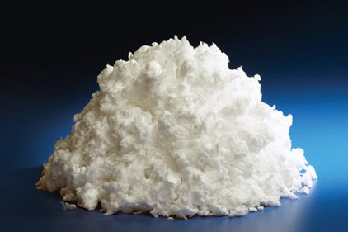
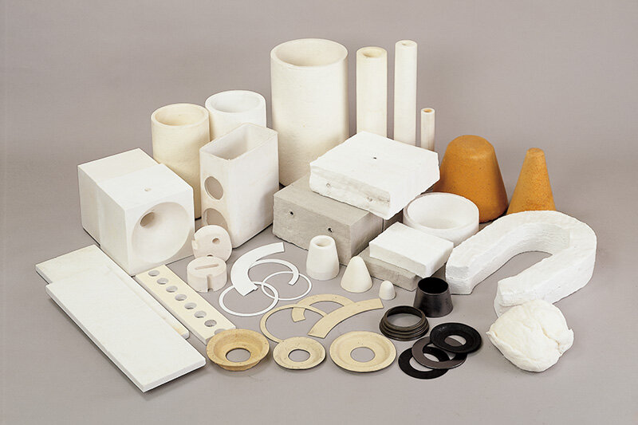
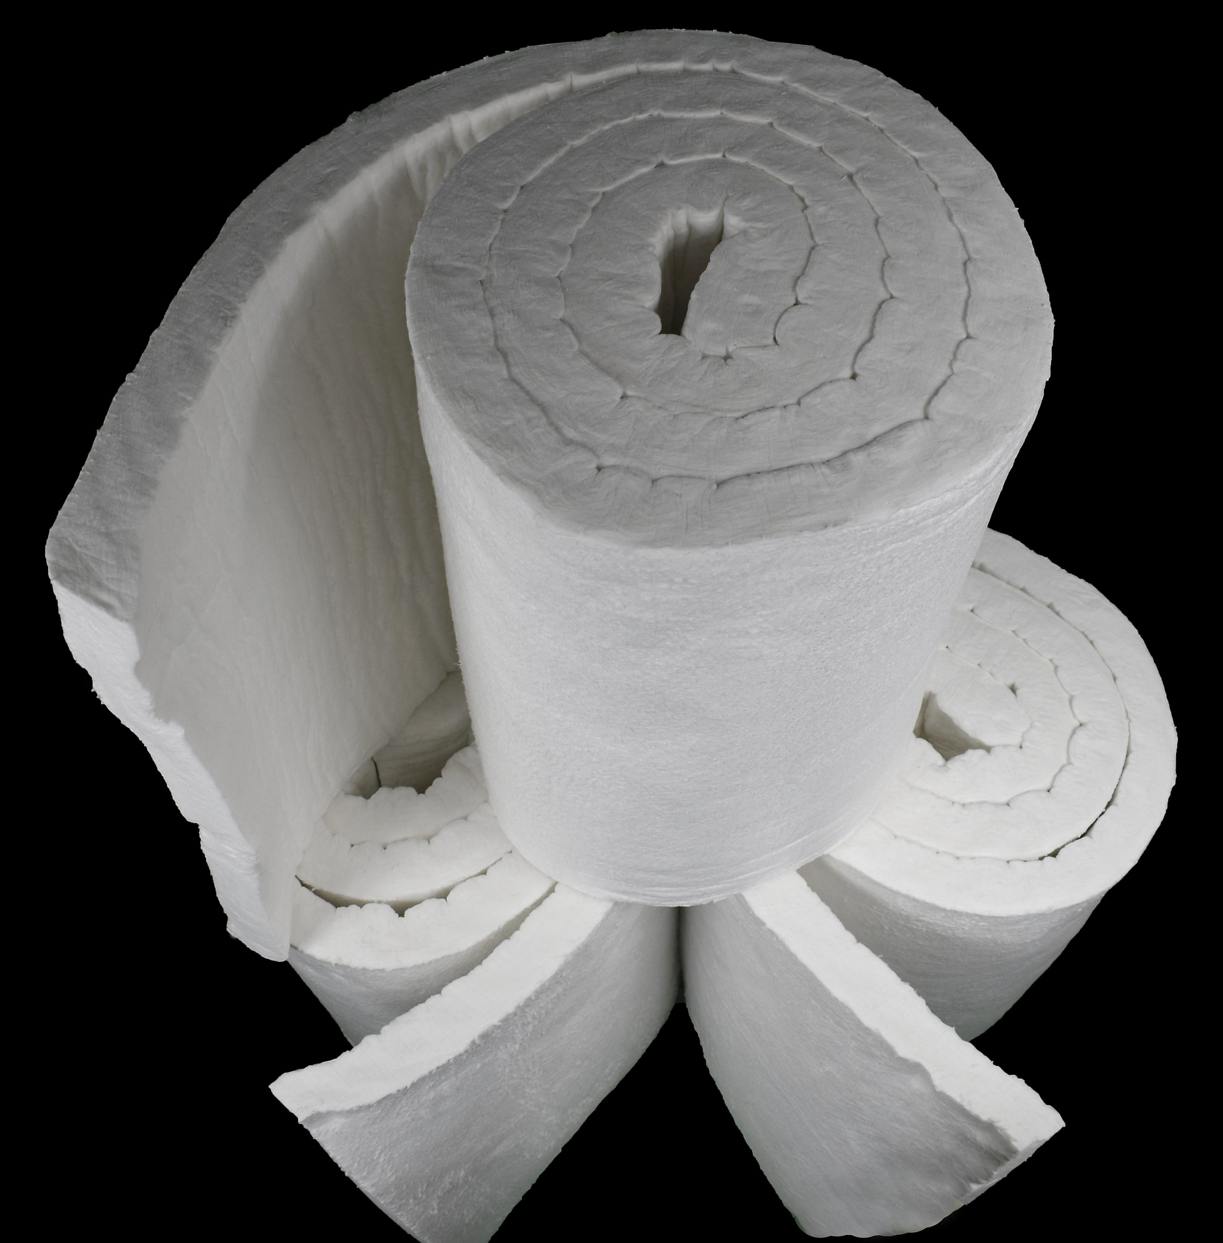
I. Material Selection
MAE 589- HEAT TRANSFER PROJECT
Lightweight insulation materials with high thermal conductivity are Preferred:
REFRACTORY CERAMIC FIBRES:
Refractory ceramics are materials that can withstand high temperatures without degrading, melting, or deforming.
RCF has low thermal conductivity, making it a good insulator for high-temperature applications.
It is lightweight and easy to install, which can save time and labor costs during installation.
RCF is flexible, making it suitable for wrapping around curved surfaces like cylinders.
They are commonly used in high-temperature applications such as furnaces, kilns, reactors, and other industrial applications where extreme heat is present.

Slide 5
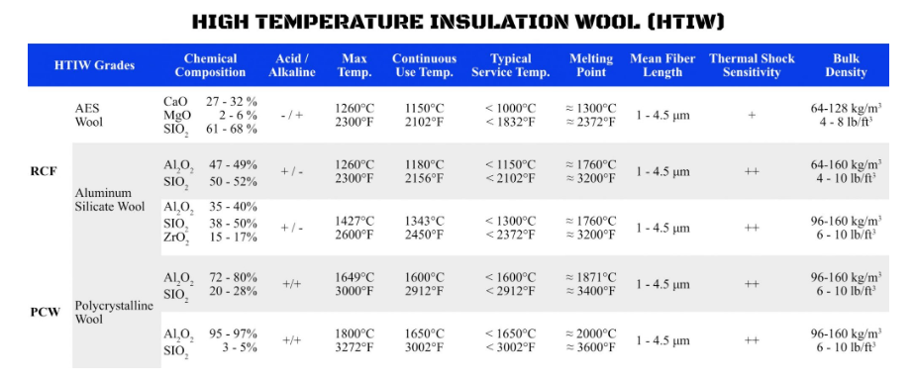
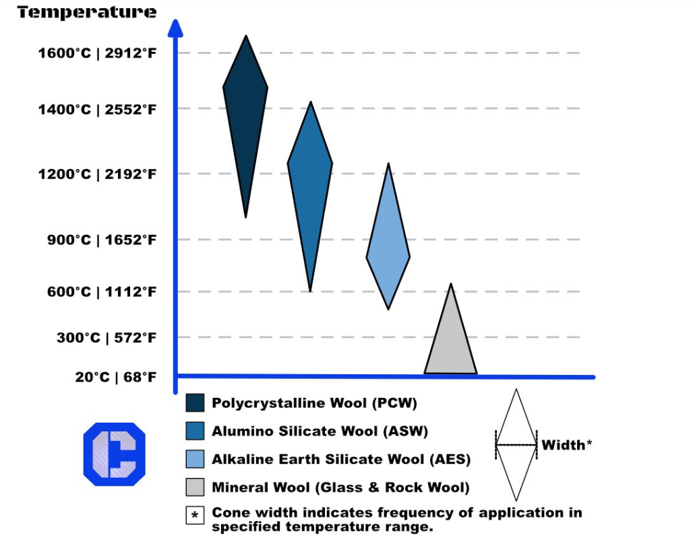
I. Material Selection
MAE 589- HEAT TRANSFER PROJECT
The physical and chemical properties of various high-temperature insulation wools.
Frequency of use and common temperature ranges for the application of HTIW products.

Slide 6
I. Material Selection
MAE 589- HEAT TRANSFER PROJECT
Polycrystalline wool:
higher temperature RCF, consisting of fibres with an al2o3 content above wt.63% and a sio2 content under wt.37% is considered.
Offers excellent resistance to thermal shock, chemical attack, and abrasion, and can withstand temperatures up to 3000°F (1650°C).
Refractory ceramic Fibre:
synthetic fibers produced by the melting and blowing or spinning of calcined kaolin clay or a combination of alumina (Al2O3), silicon dioxide (SiO2), or other oxides.
There is a higher temperature grade RCF containing about 15 percent ZrO₂ with an improved temperature rating.
RCF with AL2O2 35 – 40 wt. percent, SiO2 38 – 50 Wt. percent, and ZrO2 15 -17 Wt. percent is considered.

Slide 7
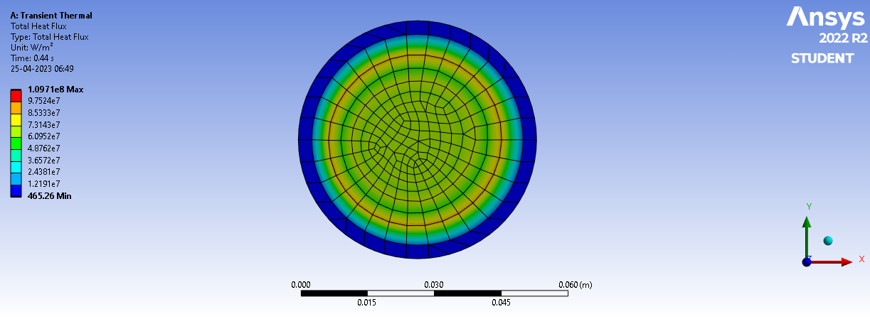
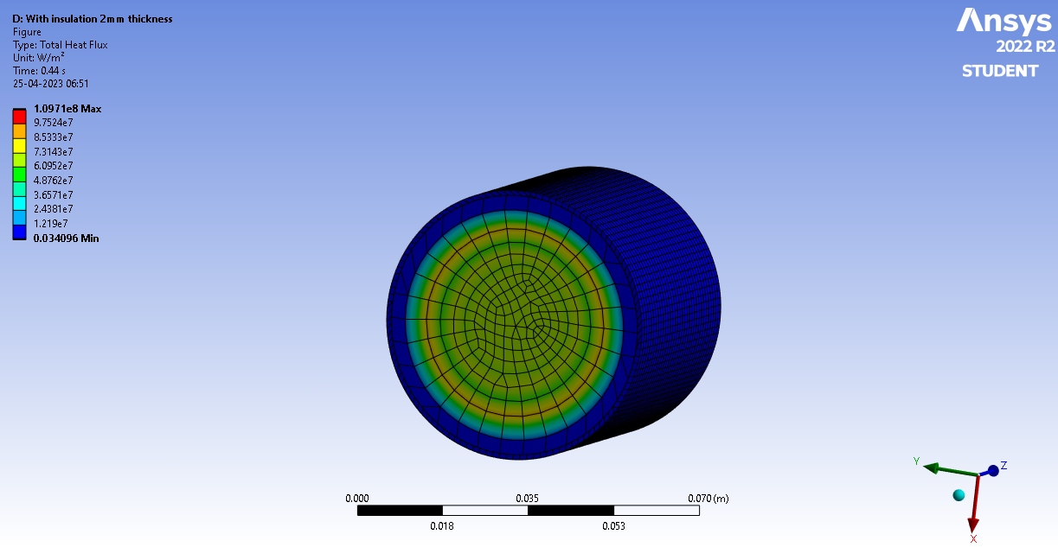
ii. CFD analysis (Polycrystalline wool Insulation)
MAE 589- HEAT TRANSFER PROJECT
With the given fuel properties and engine cylinder material properties, the heat flux from the combustion chamber is shown
With the addition of insulation material (Polycrystalline wool), there is a phenomenal drop in the heat flux

Slide 8
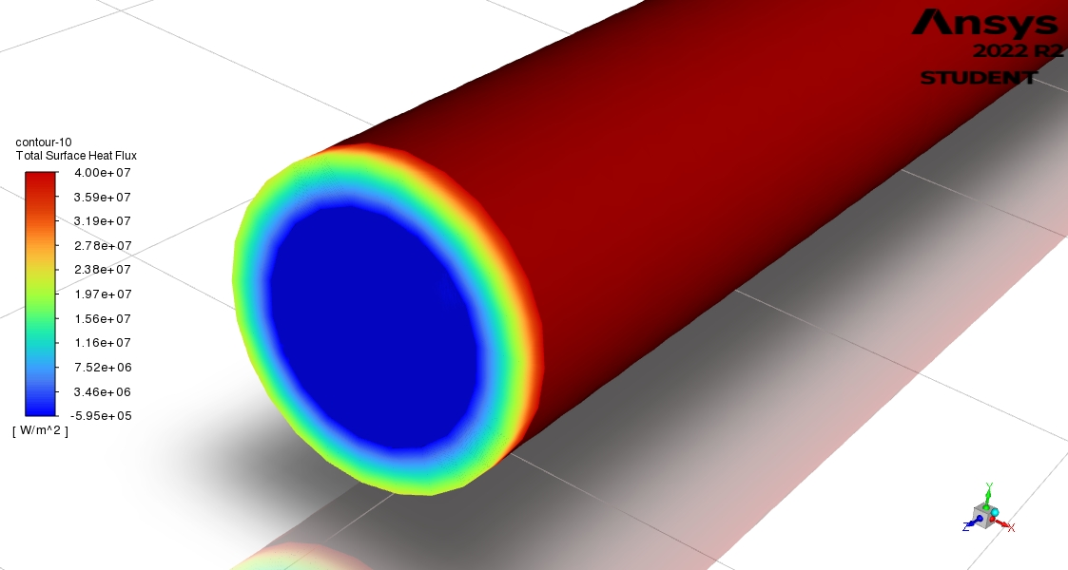
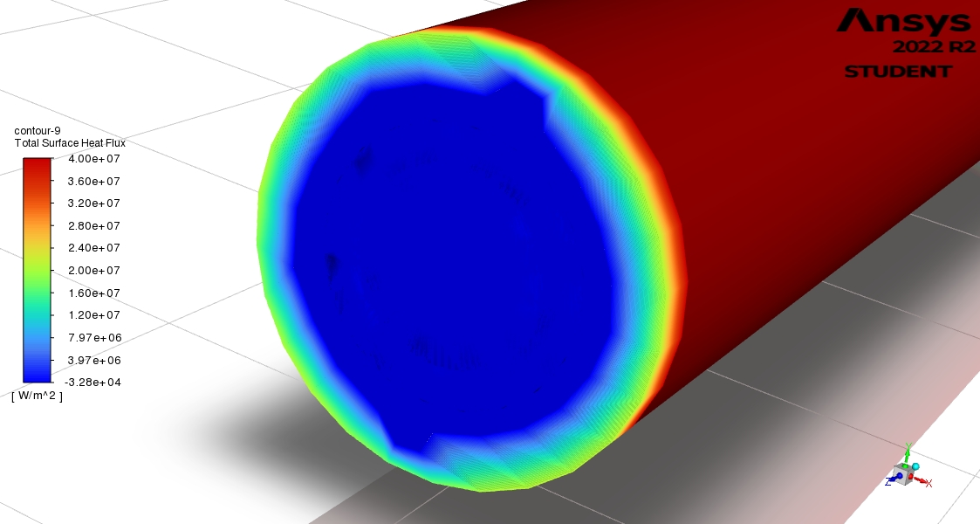
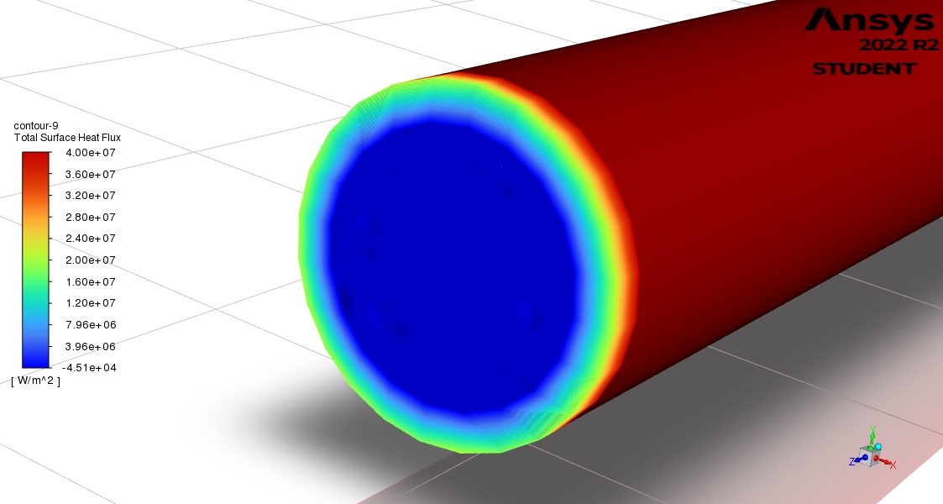
ii. CFD analysis (Polycrystalline wool insulation)
MAE 589- HEAT TRANSFER PROJECT
The heat flux coming from the engine cylinder from the previous slide is applied to the fuel lines without insulation and the heat flux going to the fuel is calculated.
Now the fuel pipe is insulated and then the analysis is repeated for different insulation thicknesses.
The analysis is done for 1mm and 3mm insulation thickness.

Slide 9
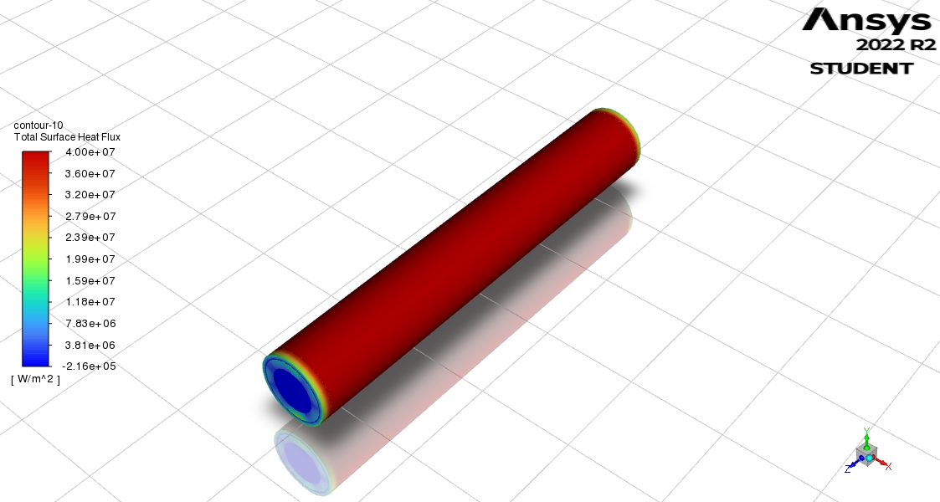
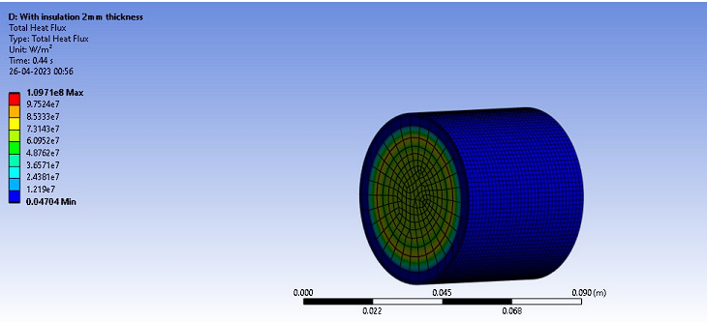
ii. CFD analysis (RCF insulation)
MAE 589- HEAT TRANSFER PROJECT
Now the fuel pipe is insulated with the RCF with AL2O2 35 – 40 wt. percent, SiO2 38 – 50 Wt. percent, and ZrO2 15 -17 Wt. percent. below are the analysis results.
After adding the insulation to the engine the final reduced heat flux from the engine.

Slide 10
MAE 589- HEAT TRANSFER PROJECT
Results observed from the CFD analysis:
From the CFD analysis, it is observed that a 1mm change in the thickness of the insulation material brought down the heat flux by 10⁴ W/m²
the objective of isolating the fuel tank and fuel lines from the engine has been achieved.
Thank you

